Slide 1

DICOM to JPEG 2000 Conversion with Integrated AES Encryption
For Secure & Fast Medical Image Transfer
Name: Aashiq Rahaman | University Roll No.: 10000122020 | Date: 08.07.2025
UNDER THE SUPERVISION OF
Mr. Santanu Chatterjee
Mr. Mihir Sing
Dr. Koushik Majumder
Department of Computer Science & Engineering,
Maulana Abul Kalam Azad University of Technology,
Kolkata-741249, W.B., India

Slide 2

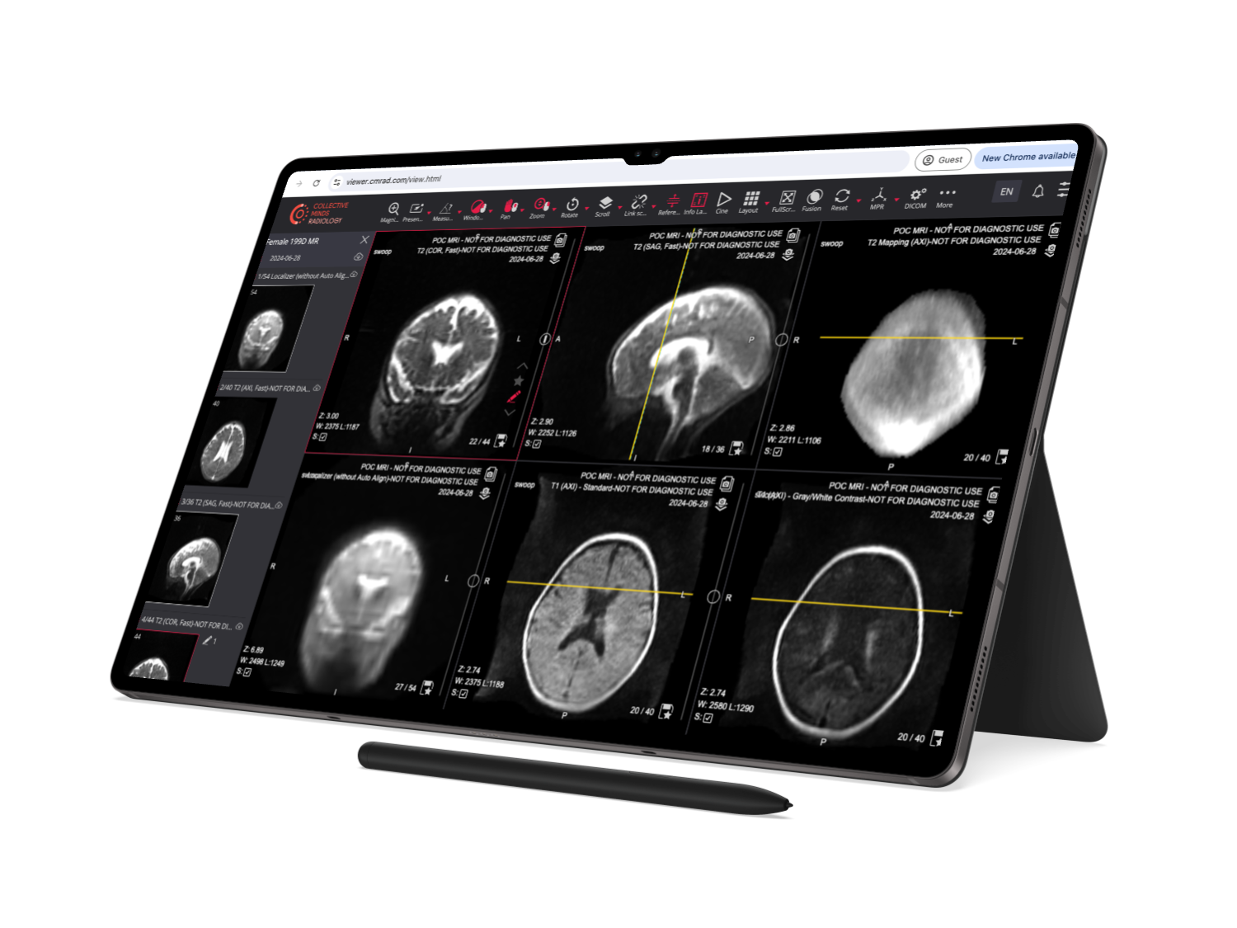
Introduction
Medical imaging technologies save lives by enabling accurate diagnostics. DICOM is the standard format, encapsulating both images and rich patient metadata. However, these files are typically large, challenging storage and bandwidth. JPEG 2000 compression provides lossless image quality preservation while reducing file size significantly. Coupled with AES encryption, this method safeguards sensitive patient information during transfer, ensuring compliance with privacy standards such as HIPAA.

Slide 3



Problem Statement
Large file sizes: DICOM files consume excessive storage and slow down transfer speeds across hospital networks.
Security risk: Patient data is vulnerable if unencrypted files are intercepted or hacked.
Hospitals require a solution that reduces file size without sacrificing image quality, while ensuring robust information security.

Slide 4

Review of Image Encryption & Conversion Techniques
Standard AES: Reliable and widely adopted but lacks optimization for unique image characteristics.
Modified AES Variants: Improve security and speed but introduce implementation complexity and maintenance overhead.
Dynamic AES: Incorporates key-dependent S-Box for increased unpredictability, enhancing resistance to attacks.
Hybrid AES + Chaotic Maps: Achieves superior security metrics like NPCR and UACI; trade-off includes elevated computational time.
JPEG 2000 Prediction: Enables rapid compression quality assessment; however, it does not provide encryption.
DICOM TO JPEG WITH AES: Integrates DICOM to JPEG 2000 conversion with AES encryption, balancing strong security and compression, presently optimized for 2D images.
Summary: Hybrid and dynamic encryption approaches deliver enhanced security, whereas DICOM TO JPEG WITH AES bridges practicality and robustness in medical imaging.

Slide 5
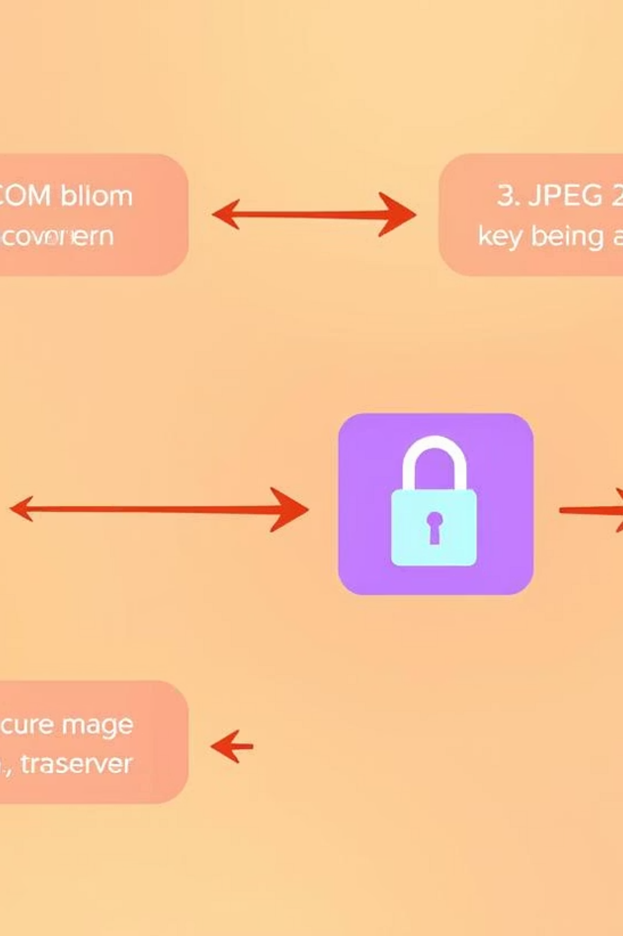
Proposed Solution
Convert bulky DICOM medical images into JPEG 2000 format, shrinking file size with no loss in diagnostic quality. Integrate AES encryption to secure images before transfer.
This enables rapid, secure sharing between healthcare facilities, maintaining patient data confidentiality.

Slide 6
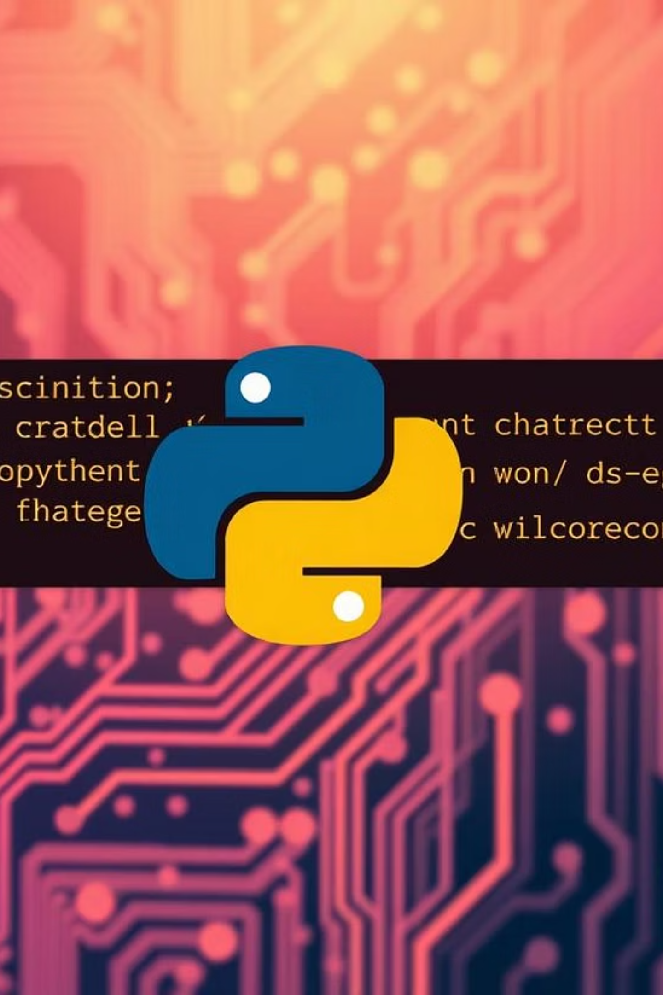
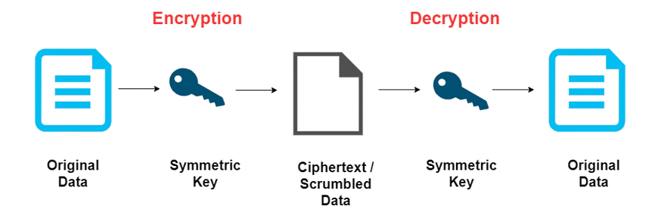
Decrypt JPEG 2000 (.jp2) file using AES in CBC mode
Technical Workflow: How It Works
Phase 1: Conversion
Read DICOM files using Python libraries
Normalize image pixel values for consistency
Save images as compressed JPEG 2000 (.jp2) files
Phase 2: Encryption
Hash user password securely with SHA-256
Encrypt JPEG 2000 file using AES in CBC mode
Store encrypted file ready for secure transmission
Phase 3: Decryption
Authenticate user (verify credentials, optional MFA)
Derive AES key (e.g. via SHA-256)
Store encrypted file ready for secure transmission

Slide 7

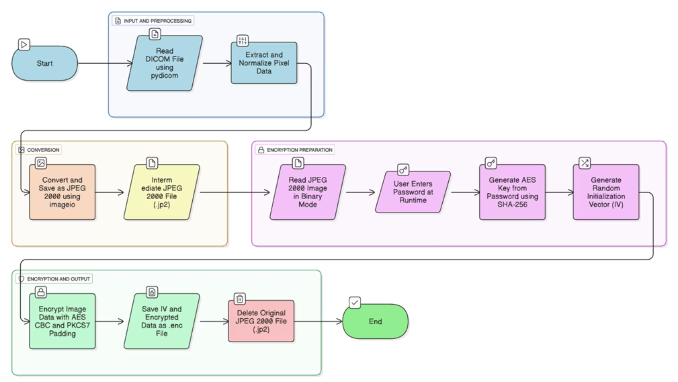
Methodology: Python Case Study
Tools Used: Python with pydicom, imageio, and pycryptodome libraries enable streamlined image processing and encryption.
Load DICOM medical images efficiently
Convert and compress to JPEG 2000 format, 79.91% file size reduction
Encrypt images with AES for data security
Decrypt images as needed for diagnosis or review

Slide 8
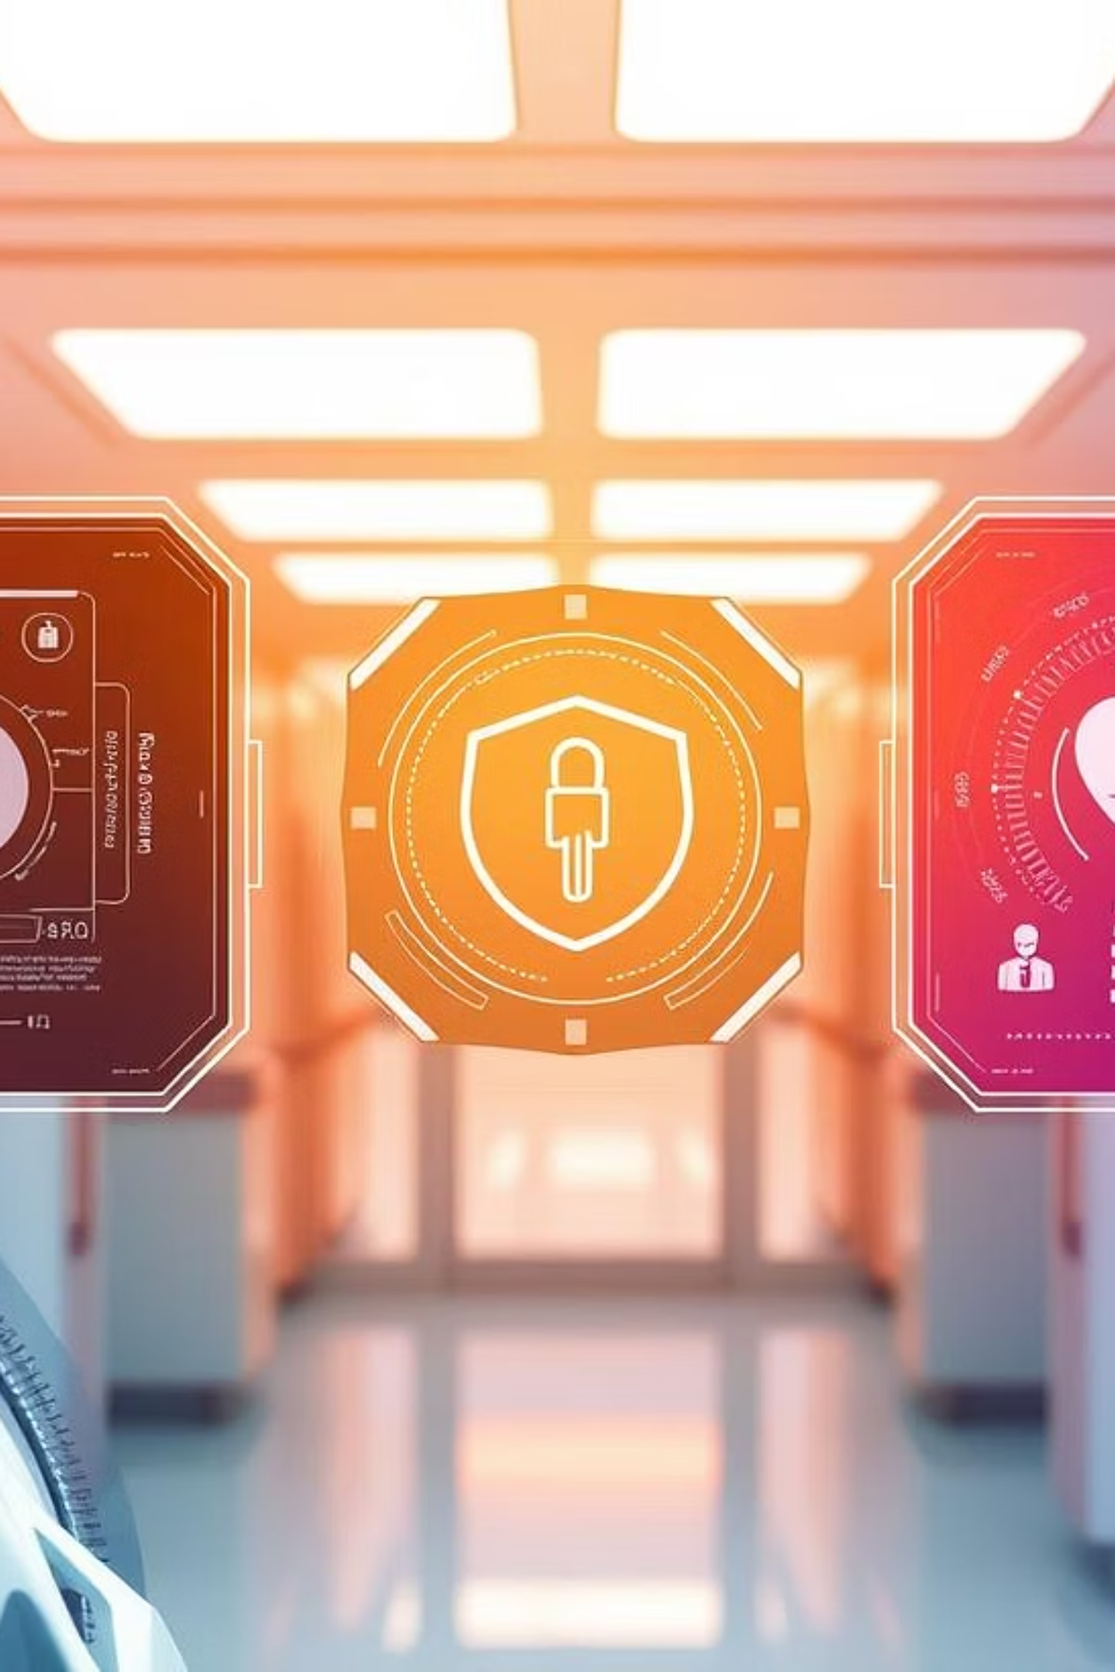



Benefits & Future Scope
Smaller Files: Significant storage savings in hospital archives.
Enhanced Security: Strong AES encryption protects patient privacy.
Faster Transfers: Accelerates image sharing and collaboration between facilities.
Future enhancements include optimizing speed for large hospitals, adding digital signatures, supporting 3D imaging and videos, PACS integration, and automating HIPAA/GDPR compliance checks.

Slide 9

Conclusion
Converting DICOM files to JPEG 2000 achieves substantial file size reduction with negligible image degradation. AES encryption integration provides robust data security, protecting patient privacy in medical image sharing. This combined approach facilitates efficient storage, faster network transfer, and compliance with data protection regulations. Our project advances the secure, scalable handling of critical medical images, enhancing clinical workflows and telemedicine efficacy.

Slide 10
References
Siam, A. A., et al. (2025). Secure Medical Imaging. IEEE ICAIC.
Gaur, P. (2023). AES Image Encryption. MAIT.
Inam, A., et al. (2023). Physica Scripta.
Chen, X., et al. (2011). Medical Physics.
Gokul, B., et al. (2023). ICECCT.

